Slide 1
XML

Slide 2
XML DTD
An XML document with correct syntax is called "Well Formed".
An XML document validated against a DTD is both "Well Formed" and "Valid".
DTD stands for Document Type Definition.
A DTD defines the structure and the legal elements and attributes of an XML document.

Slide 3
Valid XML Documents
The DOCTYPE declaration above contains a reference to a DTD file.
The DTD above is interpreted like this:
!DOCTYPE note - Defines that the root element of the document is note
!ELEMENT note - Defines that the note element must contain the elements: "to, from, heading, body"
!ELEMENT to - Defines the to element to be of type "#PCDATA"
!ELEMENT from - Defines the from element to be of type "#PCDATA"
!ELEMENT heading - Defines the heading element to be of type "#PCDATA"
!ELEMENT body - Defines the body element to be of type "#PCDATA“
#PCDATA means parseable character data.
<?xml version="1.0" encoding="UTF-8"?> <!DOCTYPE note SYSTEM "Note.dtd"> <note> <to>Tove</to> <from>Jani</from> <heading>Reminder</heading> <body>Don't forget me this weekend!</body> </note>
<!DOCTYPE note [ <!ELEMENT note (to,from,heading,body)> <!ELEMENT to (#PCDATA)> <!ELEMENT from (#PCDATA)> <!ELEMENT heading (#PCDATA)> <!ELEMENT body (#PCDATA)> ]>

Slide 4
XML DTD
When to Use a DTD?
With a DTD, independent groups of people can agree to use a standard DTD for interchanging data.
With a DTD, you can verify that the data you receive from the outside world is valid.
You can also use a DTD to verify your own data.
When NOT to Use a DTD?
XML does not require a DTD.
When you are experimenting with XML, avoid it
when you are working with small XML files, creating DTDs may be a waste of time.
If you develop applications, wait until the specification is stable before you add a DTD. Otherwise, your software might stop working because of validation errors.

Slide 5
XML Schema
An XML Schema describes the structure of an XML document, just like a DTD.
An XML document with correct syntax is called "Well Formed".
An XML document validated against an XML Schema is both "Well Formed" and "Valid".
XML Schema is an XML-based alternative to DTD

Slide 6
Valid XML Documents
The Schema above is interpreted like this:
<xs:element name="note"> defines the element called "note"
<xs:complexType> the "note" element is a complex type
<xs:sequence> the complex type is a sequence of elements
<xs:element name="to" type="xs:string"> the element "to" is of type string (text)
<xs:element name="from" type="xs:string"> the element "from" is of type string
<xs:element name="heading" type="xs:string"> the element "heading" is of type string
<xs:element name="body" type="xs:string"> the element "body" is of type string
<xs:element name="note"> <xs:complexType> <xs:sequence> <xs:element name="to" type="xs:string"/> <xs:element name="from" type="xs:string"/> <xs:element name="heading" type="xs:string"/> <xs:element name="body" type="xs:string"/> </xs:sequence> </xs:complexType> </xs:element>

Slide 7
XML Schema
XML Schemas are More Powerful than DTD
XML Schemas are written in XML
XML Schemas are extensible to additions
XML Schemas support data types
XML Schemas support namespaces

Slide 8
Why to use XML Schema
With XML Schema,
your XML files can carry a description of its own format.
independent groups of people can agree on a standard for interchanging data.
you can verify data.
XML Schemas Support Data Types
One of the greatest strengths of XML Schemas is the support for data types:
It is easier to describe document content
It is easier to define restrictions on data
It is easier to validate the correctness of data
It is easier to convert data between different data types

Slide 9
Why to use XML Schema
XML Schemas use XML Syntax
You don't have to learn a new language
You can use your XML editor to edit your Schema files
You can use your XML parser to parse your Schema files
You can manipulate your Schemas with the XML DOM
You can transform your Schemas with XSLT

Slide 10
XSL – eXtensible Stylesheet Language
XSL stands for EXtensible Stylesheet Language.
The World Wide Web Consortium (W3C) started to develop XSL because there was a need for an XML-based Stylesheet Language.
XML does not use predefined tags, and therefore the meaning of each tag is not well understood.
A <table> element could indicate an HTML table, a piece of furniture, or something else - and browsers do not know how to display it!
So, XSL describes how the XML elements should be displayed.
XSL consists of four parts:
XSLT - a language for transforming XML documents
XPath - a language for navigating in XML documents
XSL-FO - a language for formatting XML documents (discontinued in 2013)
XQuery - a language for querying XML documents

Slide 11
XSLT
stands for XSL Transformations
important part of XSL
transforms an XML document into another XML document
uses XPath to navigate in XML documents
XSLT is a W3C Recommendation

Slide 12
XSL Transformation
XSLT is the most important part of XSL.
XSLT is used to transform an XML document into
another XML document,
or another type of document that is recognized by a browser, like HTML and XHTML.
Normally XSLT does this by transforming each XML element into an (X)HTML element.
With XSLT you can add/remove elements and attributes to or from the output file.
You can also rearrange and sort elements, perform tests and make decisions about which elements to hide and display, and a lot more.
A common way to describe the transformation process is to say that XSLT transforms an XML source-tree into an XML result-tree.

Slide 13
XSLT uses XPath
XSLT uses XPath to find information in an XML document.
XPath is used to navigate through elements and attributes in XML documents.
In the transformation process, XSLT uses XPath to define parts of the source document that should match one or more predefined templates.
When a match is found, XSLT will transform the matching part of the source document into the result document.

Slide 14
XSLT Example
The root element that declares the document to be an XSL style sheet is <xsl:stylesheet> or <xsl:transform>.
<xsl:stylesheet> and <xsl:transform> are completely synonymous and either can be used
To get access to the XSLT elements, attributes and features we must declare the XSLT namespace at the top of the document.
The xmlns:xsl="http://www.w3.org/1999/XSL/Transform" points to the official W3C XSLT namespace.
If you use this namespace, you must also include the attribute version="1.0".
<xsl:stylesheet version="1.0" xmlns:xsl="http://www.w3.org/1999/XSL/Transform">
<xsl:transform version="1.0" xmlns:xsl="http://www.w3.org/1999/XSL/Transform">

Slide 15
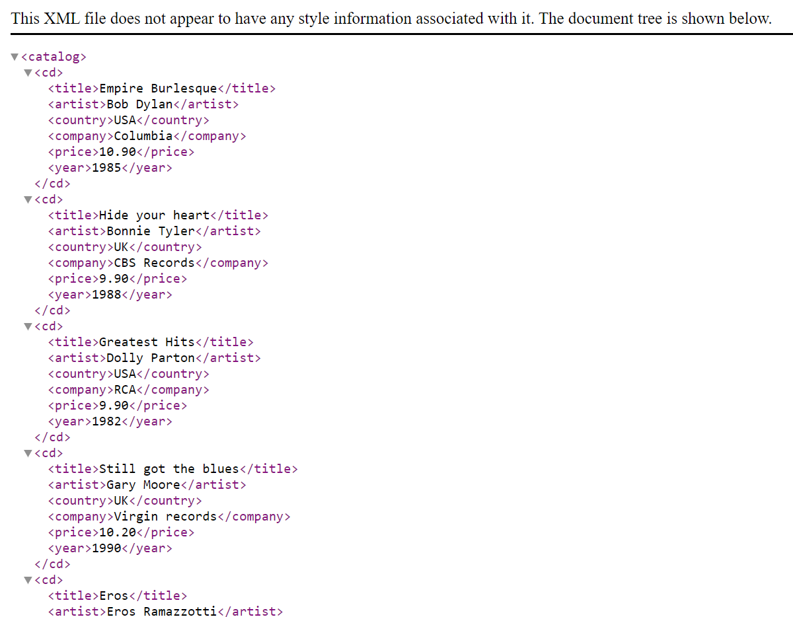
XSLT Example
Start with a Raw XML Document
We want to transform the following XML document ("cdcatalog.xml") into XHTML
<?xml version="1.0" encoding="UTF-8"?> <catalog> <cd> <title>Empire Burlesque</title> <artist>Bob Dylan</artist> <country>USA</country> <company>Columbia</company> <price>10.90</price> <year>1985</year> </cd> . . </catalog>

Slide 16
XSLT Example
Create an XSL Stylesheet
<?xml version="1.0" encoding="UTF-8"?> <xsl:stylesheet version="1.0" xmlns:xsl="http://www.w3.org/1999/XSL/Transform"> <xsl:template match="/"> <html> <body> <h2>My CD Collection</h2> <table border="1"> <tr bgcolor="#9acd32"> <th>Title</th> <th>Artist</th> </tr> <xsl:for-each select="catalog/cd"> <tr> <td><xsl:value-of select="title"/></td> <td><xsl:value-of select="artist"/></td> </tr> </xsl:for-each> </table> </body> </html> </xsl:template> </xsl:stylesheet>

Slide 17
XSLT Example
Link the XSL Style Sheet to the XML Document
Add the XSL style sheet reference to your XML document ("cdcatalog.xml"):
<?xml version="1.0" encoding="UTF-8"?> <?xml-stylesheet type="text/xsl" href="cdcatalog.xsl"?> <catalog> <cd> <title>Empire Burlesque</title> <artist>Bob Dylan</artist> <country>USA</country> <company>Columbia</company> <price>10.90</price> <year>1985</year> </cd> . . </catalog>

Slide 18
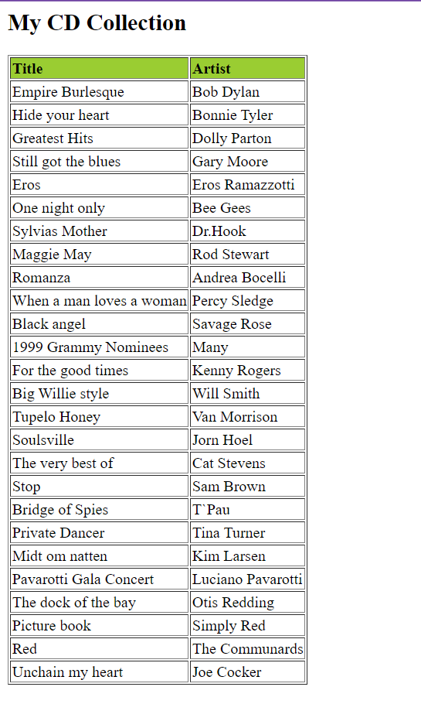
XSLT Example
Result
<?xml version="1.0" encoding="UTF-8"?> <?xml-stylesheet type="text/xsl" href="cdcatalog.xsl"?> <catalog> <cd> <title>Empire Burlesque</title> <artist>Bob Dylan</artist> <country>USA</country> <company>Columbia</company> <price>10.90</price> <year>1985</year> </cd> . . </catalog>

Slide 20
XML and HTML were designed with different goals:
XML was designed to carry data - with focus on what data is
HTML was designed to display data - with focus on how data looks
XML tags are not predefined like HTML tags are
The tags in the example above (like <to> and <from>) are not defined in any XML standard.
These tags are "invented" by the author of the XML document.
HTML works with predefined tags like <p>, <h1>, <table>, etc.
With XML, the author must define both the tags and the document structure.
XML Example
<note>
<to>Tove</to>
<from>Jani</from>
<heading>Reminder</heading>
<body>Don't forget me this weekend!</body>
</note>

Slide 21
Most XML applications will work as expected even if new data is added (or removed).
Imagine an application designed to display the original version of note.xml (<to> <from> <heading> <body>).
Then imagine a newer version of note.xml with added <date> and <hour> elements, and a removed <heading>.
The way XML is constructed, older version of the application can still work
XML is Extensible
<note>
<to>Tove</to>
<from>Jani</from>
<heading>Reminder</heading>
<body>Don't forget me this weekend!</body>
</note>
<note>
<date>2015-09-01</date>
<hour>08:30</hour>
<to>Tove</to>
<from>Jani</from>
<body>Don't forget me this weekend!</body>
</note>

Slide 22
XML Simplifies Things
Data Sharing
Many computer systems contain data in incompatible formats.
Exchanging data between incompatible systems (or upgraded systems) is a time-consuming task for web developers.
Large amounts of data must be converted, and incompatible data is often lost.
Data Transport
XML stores data in plain text format.
This provides a software- and hardware-independent way of storing, transporting, and sharing data.

Slide 23
XML Simplifies Things
Platform sharing
XML makes it easier to expand or upgrade without losing data to
new operating systems
new applications
new browsers
Data Availability
data can be available to all kinds of "reading machines" like people, computers, voice machines, news feeds, etc.

Slide 24
How to use XML?
XML Separates Data from Presentation
XML does not carry any information about how to be displayed.
The same XML data can be used in many different presentation scenarios.
Because of this, with XML, there is a full separation between data and presentation.
XML is Often a Complement to HTML
In many HTML applications, XML is used to store or transport data, while HTML is used to format and display the same data.

Slide 25
How to use XML?
XML Separates Data from HTML
When displaying data in HTML, you should not have to edit the HTML file when the data changes.
With XML, the data can be stored in separate XML files.
With a few lines of JavaScript code, you can read an XML file and update the data content of any HTML page.

Slide 26
<?xml version="1.0" encoding="UTF-8"?> <bookstore> <book category="cooking"> <title lang="en">Everyday Italian</title> <author>Giada De Laurentiis</author> <year>2005</year> <price>30.00</price> </book> <book category="children"> <title lang="en">Harry Potter</title> <author>J K. Rowling</author> <year>2005</year> <price>29.99</price> </book> <book category="web"> <title lang="en">XQuery Kick Start</title> <author>James McGovern</author> <author>Per Bothner</author> <author>Kurt Cagle</author> <author>James Linn</author> <author>Vaidyanathan Nagarajan</author> <year>2003</year> <price>49.99</price> </book> <book category="web" cover="paperback"> <title lang="en">Learning XML</title> <author>Erik T. Ray</author> <year>2003</year> <price>39.95</price> </book> </bookstore>
Books.xml
Title Author
Everyday Italian Giada De Laurentiis
Harry Potter J K. Rowling
XQuery Kick Start James McGovern
Learning XML Erik T. Ray

Slide 27
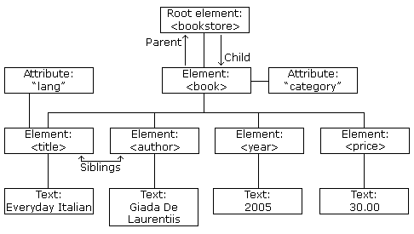
XML Tree
<?xml version="1.0" encoding="UTF-8"?> <bookstore> <book category="cooking"> <title lang="en">Everyday Italian</title> <author>Giada De Laurentiis</author> <year>2005</year> <price>30.00</price> </book> <book category="children"> <title lang="en">Harry Potter</title> <author>J K. Rowling</author> <year>2005</year> <price>29.99</price> </book> <book category="web"> <title lang="en">Learning XML</title> <author>Erik T. Ray</author> <year>2003</year> <price>39.95</price> </book> </bookstore>

Slide 28
XML documents are formed as element trees.
An XML tree starts at a root element and branches from the root to child elements.
All elements can have sub elements (child elements):
<root>
<child>
<subchild>.....</subchild>
</child>
</root>
The terms parent, child, and sibling are used to describe the relationships between elements.
Parents have children. Children have parents. Siblings are children on the same level (brothers and sisters).
All elements can have text content (Harry Potter) and attributes (category="cooking").
XML Tree
<?xml version="1.0" encoding="UTF-8"?> <bookstore> <book category="cooking"> <title lang="en">Everyday Italian</title> <author>Giada De Laurentiis</author> <year>2005</year> <price>30.00</price> </book> <book category="children"> <title lang="en">Harry Potter</title> <author>J K. Rowling</author> <year>2005</year> <price>29.99</price> </book> <book category="web"> <title lang="en">Learning XML</title> <author>Erik T. Ray</author> <year>2003</year> <price>39.95</price> </book> </bookstore>

Slide 29
XML document must have ROOT element
XML Prolog: Optional, if exist then first statement
All XML elements must have closing tag
XML tags are case sensitive
XML elements must be properly nested
XML Attribute Values Must Always be Quoted
White space is preserved in XML
Entity Reference
&lt; < less than
&gt; > greater than
&amp; & ampersand
&apos; ' apostrophe
&quot; " quotation mark
XML Syntax Rule
<?xml version="1.0" encoding="UTF-8"?> <bookstore> <book category="cooking"> <title lang="en">Everyday Italian</title> <author>Giada De Laurentiis</author> <year>2005</year> <price>30.00</price> </book> <book category="children"> <title lang="en">Harry Potter</title> <author>J K. Rowling</author> <year>2005</year> <price>29.99</price> </book> <book category="web"> <title lang="en">Learning XML</title> <author>Erik T. Ray</author> <year>2003</year> <price>39.95</price> </book> </bookstore>

Slide 30
XML HTTPRequest
All modern browsers have a built-in XMLHttpRequest object to request data from a server.
The XMLHttpRequest object can be used to request data from a web server.
The XMLHttpRequest object is a developers dream, because you can:
Update a web page without reloading the page
Request data from a server - after the page has loaded
Receive data from a server - after the page has loaded
Send data to a server - in the background

Slide 31
Sending an XMLHTTPRequest
The first line in the example above creates an XMLHttpRequest object
The onreadystatechange property specifies a function to be executed every time the status of the XMLHttpRequest object changes
When readyState property is 4 and the status property is 200, the response is ready
The responseText property returns the server response as a text string.
The text string can be used to update a web page
var xhttp = new XMLHttpRequest(); xhttp.onreadystatechange = function() { if (this.readyState == 4 && this.status == 200) { // Typical action to be performed when the document is ready: document.getElementById("demo").innerHTML = xhttp.responseText; } }; xhttp.open("GET", "filename", true); xhttp.send();

Slide 32
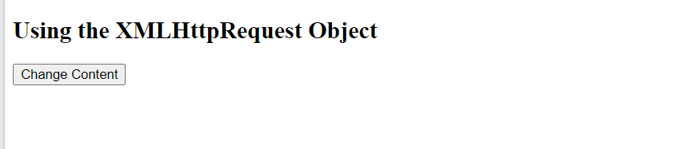
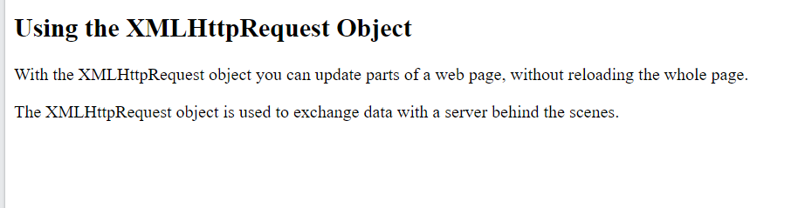
<!DOCTYPE html>
<html>
<body>
<h2>Using the XMLHttpRequest Object</h2>
<div id="demo">
<button type="button" onclick="loadXMLDoc()">Change Content</button>
</div>
<script>
function loadXMLDoc() {
var xmlhttp;
if (window.XMLHttpRequest) {
xmlhttp = new XMLHttpRequest();
} else {
// code for older browsers
xmlhttp = new ActiveXObject("Microsoft.XMLHTTP");
}
xmlhttp.onreadystatechange = function() {
if (this.readyState == 4 && this.status == 200) {
document.getElementById("demo").innerHTML =
this.responseText;
}
};
xmlhttp.open("GET", "xmlhttp_info.txt", true);
xmlhttp.send();
}
</script>
</body>
</html>
Sending an XMLHTTPRequest

Slide 33
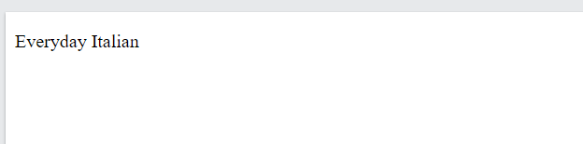
XML Parser
<html> <body> <p id="demo"></p> <script> var text, parser, xmlDoc;
// text string is defined text = "<bookstore><book>" + "<title>Everyday Italian</title>" + "<author>Giada De Laurentiis</author>" + "<year>2005</year>" + "</book></bookstore>";
parser = new DOMParser(); xmlDoc = parser.parseFromString(text,"text/xml"); document.getElementById("demo").innerHTML = xmlDoc.getElementsByTagName("title")[0].childNodes[0].nodeValue; </script> </body> </html>
The XML DOM (Document Object Model) defines the properties and methods for accessing and editing XML.
However, before an XML document can be accessed, it must be loaded into an XML DOM object.
All modern browsers have a built-in XML parser that can convert text into an XML DOM object.

Slide 34
XML Parser
<html> <body> <p id="demo"></p> <script> var text, parser, xmlDoc;
// text string is defined text = "<bookstore><book>" + "<title>Everyday Italian</title>" + "<author>Giada De Laurentiis</author>" + "<year>2005</year>" + "</book></bookstore>";
parser = new DOMParser(); xmlDoc = parser.parseFromString(text,"text/xml"); document.getElementById("demo").innerHTML = xmlDoc.getElementsByTagName("title")[0].childNodes[0].nodeValue; </script> </body> </html>
All XML elements can be accessed through the XML DOM.
This code retrieves the text value of the first <title> element in an XML document:
Example
txt = xmlDoc.getElementsByTagName("title")[0].childNodes[0].nodeValue;
The XML DOM is a standard for how to get, change, add, and delete XML elements.
This example loads a text string into an XML DOM object, and extracts the info from it with JavaScript:

Slide 35
XPath
is a major element in the XSLT standard.
can be used to navigate through elements and attributes in an XML document.
is a syntax for defining parts of an XML document
uses path expressions to navigate in XML documents
contains a library of standard functions
is a major element in XSLT and in XQuery
is a W3C recommendation

Slide 36
Xpath Path Expression
XPath uses path expressions to select nodes or node-sets in an XML document.
These path expressions look very much like the expressions you see when you work with a traditional computer file system.
XPath expressions can be used in JavaScript, Java, XML Schema, PHP, Python, C and C++, and lots of other languages.

Slide 37
Xpath Path Expression
XPath Expression Result
/bookstore/book[1] Selects the first book element that is the child of the bookstore element
/bookstore/book[last()] Selects the last book element that is the child of the bookstore element
/bookstore/book[last()-1] Selects the last but one book element that is the child of the bookstore element
/bookstore/book[position()<3] Selects the first two book elements that are children of the bookstore element
//title[@lang] Selects all the title elements that have an attribute named lang
//title[@lang='en’] Selects all the title elements that have a "lang" attribute with a value of "en"
/bookstore/book[price>35.00] Selects all the book elements of the bookstore element that have a price element with a value greater than 35.00
/bookstore/book[price>35.00]/title Selects all the title elements of the book elements of the bookstore element that have a price element with a value greater than 35.00

